Slide 1

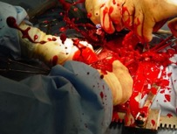
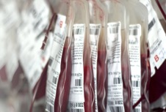
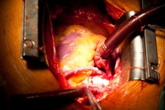
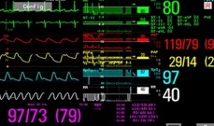
CARE OF THE POST-OPERATIVE HEART PATIENT
PART 1
Bravein Amalakuhan, MD
Division of Pulmonary and Critical Care Medicine University of Texas Health, San Antonio

Slide 2
OUTLINE
PART 1
Culture & Psychology
Cardiac Surgical Critical Care: The Entity
Understanding Cardiopulmonary Bypass
Hand-offs & Routine Post-Operative Care
Procedure Specific Considerations/
Management
Management of Common Complications
STS Quality/Performance Measures
Foundational Knowledge
The Basics
POD#0 to Downgrade
PART 2
Advanced Details
“Emergencies”
APPLICATION

Slide 3
LOOK FOR THIS SYMBOL THROUGH OUT THE LECTURE
STS QUALITY ALERT

Slide 4

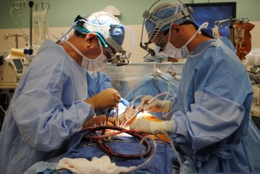
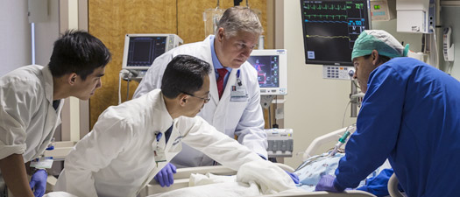

CARDIAC SURGICAL CRITICAL CARE MEDICINE
Culture & Psychology

Slide 5


Cardiac Surgical ICU (CSICU)
Providers in the CSICU
Cardiothoracic Surgeons
Interventional Cardiologists
Heart Failure Cardiologists
Intensivists
Who is the Primary Provider in Surgical Patients?
Culturally: Cardiac Surgeon
Building Trust Within the Team
Acquisition of knowledge
Communication & Respect
Recognizing each others strengths and limitations
Focusing on the Patient
JUNGLE
Contemporary: Cardiac Surgeon + Intensivist

Slide 6

“Close collaboration between the Intensivist and Operating Surgeon is essential for comprehensive post-operative care”
–Dr.Nevin Katz
(President of the Foundation for the Advancement of Cardiothoracic Surgical Care aka FACTS-Care)
Intensivist Involvement after Cardiac Surgery
Postoperative Duration on Mechanical Ventilation
Blood Product Transfusion
Hospital LOS
Total Health Care Costs
IMPROVES CLINICAL OUTCOMES
Knowledge is Key
Kumar et al. Ann Thorac Surg (2009)
Dimick et al. Crit Care Med (2001)
Notes:
61% decrease in hospital costs
Decrease in hospital LOS by 6 days
13 million saved in an 18 bed CTICU

Slide 7
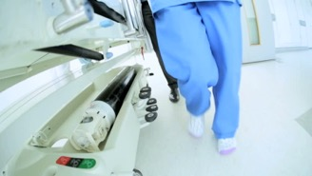

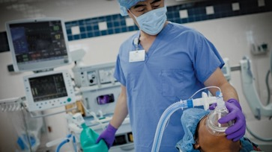
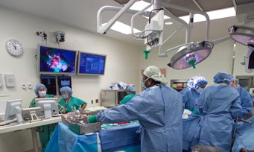
THE OPERATING ROOM

Slide 8
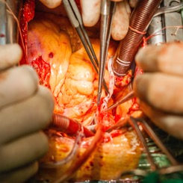
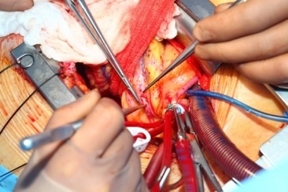

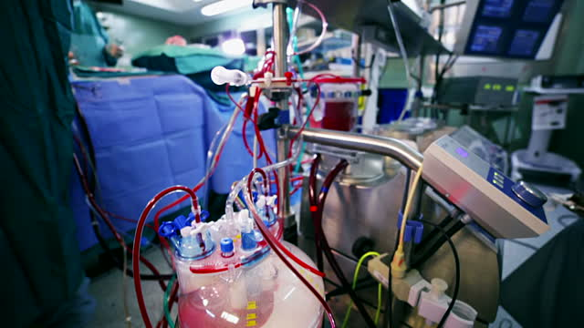
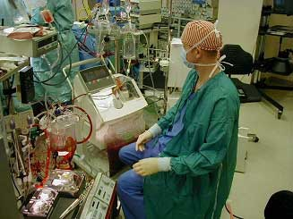
CARDIOPULMONARY BYPASS

Slide 9
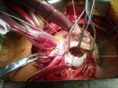
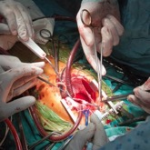
CARDIOPULMONARY BYPASS (CPB)
The foundation of cardiac surgery
Why use it?
Supports the circulation in the arrested/non-beating heart
Provides a motionless field
Provides a bloodless field
Allows the surgeon to perform cardiac surgery safely
WHAT IS IT?
HOW DOES IT ACTUALLY WORK?
Stephens et al. CCM (2015)

Slide 10
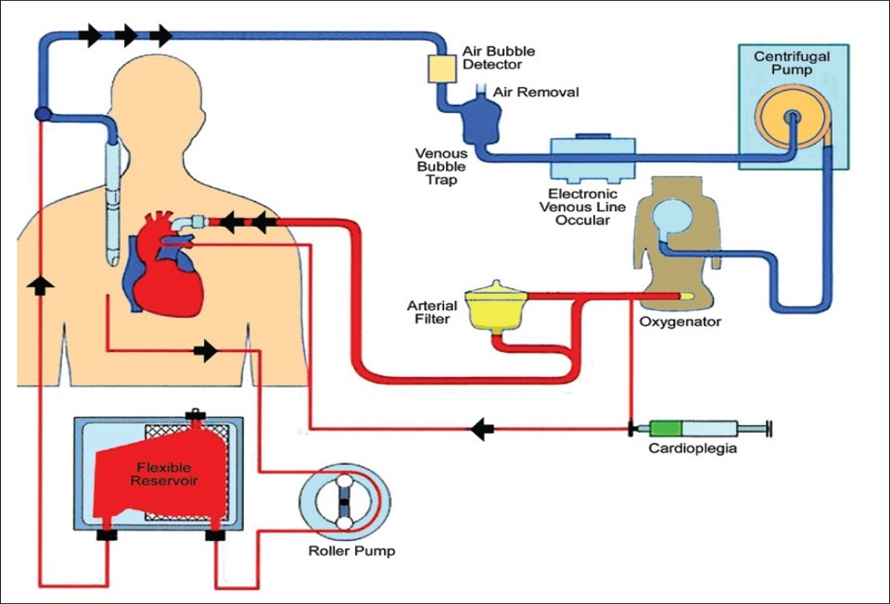
CARDIOPULMONARY BYPASS MACHINE
Cardioplegic Solution
High K+ solution to stop contractions/electrical impulses
Cools heart to decrease oxygen demand

Slide 11
CARDIOPULMONARY BYPASS MACHINE

Slide 12
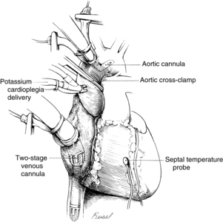
Expose Heart
Aortic Cannulation
Atrial Cannulation
Run Bypass Machine
Cardioplegia Cannulation
Cross Clamp Aorta
Begin Cold Cardioplegia
Cool Heart with ICE
LET’S GET TO WORK!!!

Slide 13
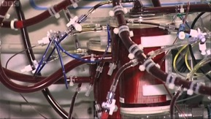
DIRECT CONSEQUENCES OF CPB
Systemic Inflammatory Response (SIRS) [“Vasoplegia”]
Cause: Interaction between blood and the artificial tubing of CPB
Biochemical/physiological similary to sepsis
Presentation: Vasodilation and Hypotension
Multifactorial Coagulopathy
Presentation: Bleeding
Causes:
The CPB circuit is thrombogenic and thus requires high doses of heparin to reduce embolic phenomenon in the OR
The CPB circuit leads to PLT activation, consumption and dysfxn
The SIRS response results in consumptive coagulopathy
Induced hypothermia interferes with normal coagulation
Crystalloids used to prime the CPB circuit results in dilutional coagulopathy and anemia
Stephens et al. CCM (2015)
Notes:
Abnormal surfaces/membranes

Slide 14
DIRECT CONSEQUENCES FROM CPB
Total Body Volume Overload
Presentation: Pulmonary edema, RV Overload
Causes:
A direct result of crystalloid priming of the CPB circuit
Ongoing volume requirements due to vasodilation and endothelial leak while on CPB
Vascular Injury at Cannulation Sites
Presentation: Femoral/aortic dissections, hematomas, impaired distal perfusion, right atrial cannulation sites can be foci of atrial arrhythmias
Causes: Direct cannulation during CPB and shearing forces
Atheroemboli / Embolic Phenomenon
Presentation: Strokes, peripheral embolic/end organ damage
Causes: Aortic cross clamping and aortic cannulation
Stephens et al. CCM (2015)

Slide 15
DIRECT CONSEQUENCES FROM CPB
Conduction Abnormalities / Myocardial Dysfunction
Presentation: Heart blocks, arrhythmias
Causes: Inadequate cardioplegia (+ long cross clamp/bypass times)
resulting in cardiac myocardial ischemia,
ANTICIPATION
EARLY RECOGNITION
EARLY TREATMENT
IMPROVED OUTCOMES
Stephens et al. CCM (2015)

Slide 16
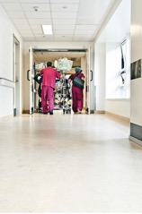
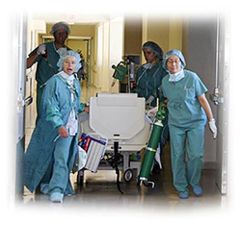
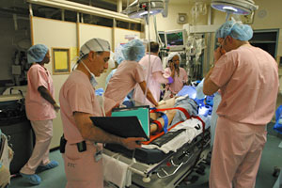
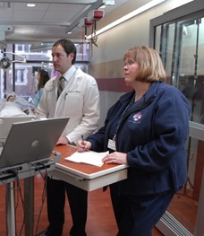
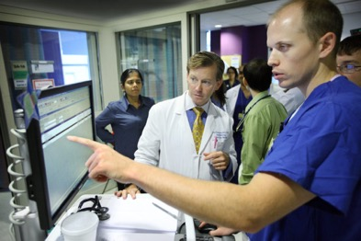

ADMISSION TO THE ICU AND TRANSFER OF CARE

Slide 17
ADMISSION / TRANSFER TO THE ICU
Formal handover of information from the surgical / anesthesia teams to the ICU team is REQUIRED
Key Components of Presentation / Hand-Off:
Indications for surgery, type of surgery, Notable events in OR
CPB time, cross clamp time, TEE results at end of case
Amount of blood products given
Hemodynamic values at the end of the case (CVP, Swan #s)
Temporary Epicardial Pacemaker Variables (settings, thresholds)
Current temperature and whether paralytics were reversed?
Current Ventilator Settings
Lab values at the end of the case and whether replaced
Plans for weaning off Inotropes/Pressors
Goal hemodynamic parameters
Any special plans, deviating from “standard fast track course”
Johns Hopkins University Cardiac Surgical Hand-off Check-List

Slide 18

ADMISSION / TRANSFER TO THE ICU
The ICU team should have the opportunity to ask questions of both the surgical and anesthesia teams.
Formal hand-offs have been shown to:
Decrease critical omissions
Decrease time on ventilator
Decrease unplanned extubations
Decrease in overall post-operative complications
Improved 24-hour patient outcomes
Improved perceived team work
Stephens et al. CCM (2015)
Agarwal et al. CCM (2012)

Slide 19
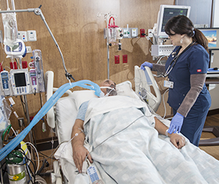
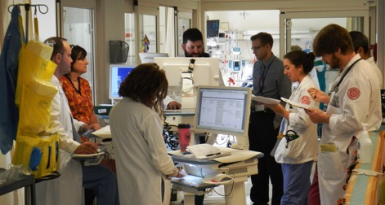
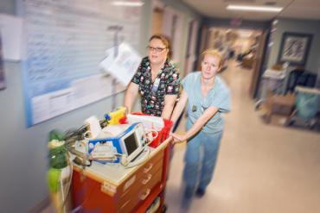
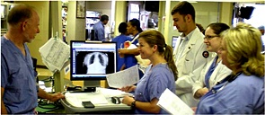
ROUTINE POST-OPERATIVE CARE: THE BASICS

Slide 20


INITIAL STUDIES
Full set of Labs
CMP, CBC with diff, Calcium, Mg, P, ABG, glucose, lactic acid, Coag’s, mixed venous blood gas (or mixed central venous)
Obtain daily and replace as needed
Troponin Levels:
Immediate postoperative levels → NOT CLINICALLY USEFUL
Persistent elevation 24-hours post-op → CARDIAC MORTALITY
12-Lead EKG
Obtain baseline & daily → changes on POD#1 may be useful
ST Changes are not clinically useful in the early post-op period!!!
New q-waves
Sign of a Perioperative MI
Predictive of mortality if coupled with a new rise in troponins
Detection of new conduction abnormalities
Stephens et al. CCM (2015)
CLINICAL CONTEXT
CLINICAL CONTEXT

Slide 21
MONITORING AND INITIAL STUDIES
Chest Radiographs
Upon admission to ICU
Exclude PTX/Hemothorax
Verify placement of lines, tubes, devices
Routine CXRs after POD#1 are not indicated
Stephens et al. CCM (2015)

Slide 22
HEMODYNAMIC MANAGEMENT
General Principles
What to Expect:
Hemodynamic lability
Post-Op myocardial dysfunction, decreased ventricular compliance, intravascular hypovolemia, vasodilation
Follow Trends!
Bleeding (chest tube output)
Hemodynamic Values: CVP, Urine output, PAP’s, MAP’s
How to Manage?
Appropriately manipulate the following:
Preload
Inotropic Support
Afterload
Stephens et al. CCM (2015)

Slide 23
HEMODYNAMIC MANAGEMENT
Blood Pressure Goals
Little data for guidance post cardiac surgery.
Depends on the type of surgery, physiological principles, surgeon/intensivist/”expert” experience
General Goals: MAP 60-90mmHg, SBP 90-140mmHg
Higher MAP goals:
Chronic Hypertension
Renal Insufficiency
Lower MAP goals:
Mitral Valve Repair
Vulnerable Aortic Suture Lines
Active bleeding
Poor Indicator of Systemic Perfusion
Do not use as sole hemodynamic goal
Stephens et al. CCM (2015)
St.Andre et al. CCM (2005)

Slide 24
HEMODYNAMIC MANAGEMENT
Pre-Load
Adequate preload is key to optimal cardiac function
Determining Fluid Responsiveness after Cardiac Surgery
No data to support a single method
Even dynamic approaches are inaccurate here
Clinical judgement based on multiple hemodynamic parameters + TTE is recommended
Role of ‘Central Venous Pressure’ (CVP)
Static values are not good predictors of RV overload or “Dry”
Decreasing or Increasing trends provide some insight
Utility in Cardiac Surgical Patients
Increasing trends in CVP + Hypotension
Sign of RV overload ➔ May need Diuresis or Inotropy
Trof et al. CCM (2001)
Breukers et al. EJCS (2009)
Potter et al. J Crit Care (2013)

Slide 25
HEMODYNAMIC MANAGEMENT
Clinical and Laboratory Assessment of Perfusion
Urine Output:
Adequate urine output (0.5cc/kg/hr) is reassuring
Decreased urine output may be a ”Red-Flag” for hypo-perfusion
Should be supplemented by objective data
Lactate Levels:
Minimally elevated levels (>2 mmol/L)
Sign of occult hypoperfusion
Higher lactate levels (>3-4 mmol/L)
Predictive of major complications post-op
Stephens et al. CCM (2015)
Hajjar et al. JTCS (2013)

Slide 26
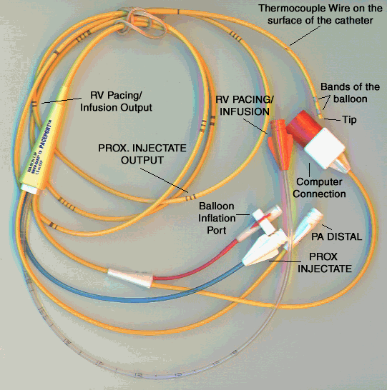
HEMODYNAMIC MANAGEMENT
Cardiac Output and Venous Oxygen Saturation
Gold Standard for Cardiac Output Measurement
Thermodilution using a Swan
Other Methods of Measuring Cardiac Output
Arterial Pulse Wave-Form Analysis [e.g. LiDCO, Vigileo]
Inaccurate after cardiac surgery
Mixed Venous Oxygenation (Sv02 or Scv02) & Fick
Data is mixed as to its accuracy
Sv02 of >60-70% is generally reassuring
A significant difference between Scv02 (IJ) and Sv02 (Swan) may predict post-operative complications!!!! --> L to R Shunt
Goal CI: 2.2 – 2.5 L/min/m2
Stephens et al. CCM (2015)

Slide 27
HEMODYNAMIC MANAGEMENT
Fluid Resuscitation
The most important hemodynamc intervention in the early post-operative period.
4 major contributors to the need for intravascular volume replacement
Blood loss
Increased vascular capacitance with rewarming
Third space fluid losses due to CPB-induced inflammation
Myocardial stunning and decreased ventricular compliance
Crystalloids are preferred [2nd line: Albumin]
If after 2-3L of Crystalloids and still hypotensive → Look for other causes [TTE, CXR, Labs]
-Bleeding
-Tamponade
-Tension PTX
-Surgical Issue
Stephens et al. CCM (2015)

Slide 28
HEMODYNAMIC MANAGEMENT
Inotropic and Vasopressor Support
Temporary ventricular and vascular dysfunction are common after cardiac surgery
Almost all patients require inotropic/vasopressor support upon separation from CPB
Little data to support one vasoactive agent over another
Titrating up vasopressors to achieve a higher MAP does not necessarily indicate an increase in CO!!!!!!
Increased afterload, decreased stroke volume/systemic perfusion
Use Inotropes and Vasopressors Judiciously
Stephens et al. CCM (2015)

Slide 29
HEMODYNAMIC MANAGEMENT
Inotropic and Vasopressor Support
Choices:
Norepinephrine + Dobutamine is equally efficacious and safer than epinephrine alone
Norepinehrine is superior to DA for cardiogenic shock
PDEi (e.g. milrinone): Inotropy, Pulmonary Vasodilator, Inodilator (use with Norepinephrine), but longer half-life (30-60min)
If using Inodilators (Dobutamine, Milrinone), start with Norepinephrine
Avoid DA [increased oxygen demand and arrhythmias]
Excessive Vasoplegic Shock
1st-line: Norepinephrine + Vasopressin
Resistant: Methylene Blue Drip
Avoid Phenylephrine: Increases afterload & decreases graft flow
Stephens et al. CCM (2015)

Slide 30
Stephens et al. CCM (2015)

Slide 31
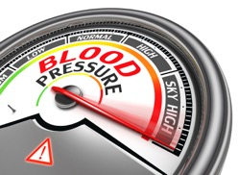
HEMODYNAMIC MANAGEMENT
Vasodilators & Afterload Reduction
Post-operative HTN is a frequent problem
Consequences of Post-Operative HTN
Increases afterload and worsens cardiac function
Increases bleeding
Threatens fragile anastomoses (aortic suture lines)
Choices:
Nitroglycerin
Nitroprusside
Nicardipine
Underappreciated
Stephens et al. CCM (2015)

Slide 32
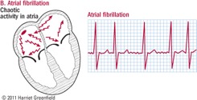
HEMODYNAMIC MANAGEMENT
Arrhythmias: Prophylaxis and Management
Supraventricular Arrhythmias [e.g. Atrial Fibrillation/Flutter]
Incidence: 30-40% of patients
Loss of atrial contraction → Impairs CO
Associated with poor outcomes:
Prolonged hospital stays
Higher costs
Increased risk of stroke
Risk-Factors:
Advance age
Sleep apnea
Prior arrhythmia or CHF
Bicaval cannulation
Long CPB runs
Prophylaxis:
Decreases prevalence of afib by nearly 50%
1st-line: Amiodarone
2nd-line: B-Blocker
STS QUALITY ALERT
Stephens et al. CCM (2015)

Slide 33
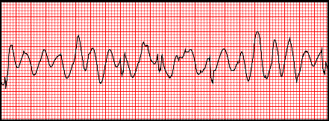
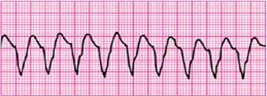
HEMODYNAMIC MANAGEMENT
Arrhythmias: Prophylaxis and Management
Arrhythmias: Prophylaxis and Management
Ventricular Arrhythmias:
Uncommon
A sign of ongoing ischemia
Treatment:
Replace Electrolytes
Hemodynamically Stable: Amiodarone
Hemodynamically Unstable: Electrical Cardioversion
Stephens et al. CCM (2015)

Slide 34
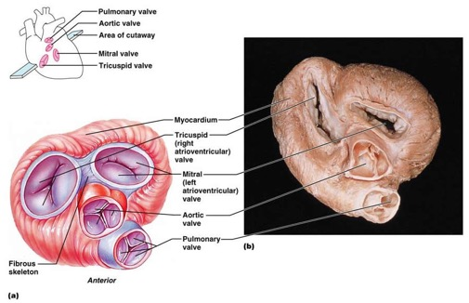
HEMODYNAMIC MANAGEMENT
Bradycardias
Causes:
Damage/trauma to conductive tissue during valve surgery
The AV node is in juxtaposition to the annula of MV, AV, TV
Sinus Asystole
Sinus Bradycardia
Junctional Bradycardia
AV Conduction Delays
Complete Heart Block
Stephens et al. CCM (2015)

Slide 35
HEMODYNAMIC MANAGEMENT
Temporary Epicardial Pacemakers for Bradycardia
Placed on nearly all post-op hearts intra-operatively
Placement:
Usually both atrial and ventricular pacer wires
In low risk patients → ventricular pacer wires will suffice
Pacing Method:
If No Conduction Block: ‘Atrial Pacing’ is preferred
SV is greatest when electrical impulse originates here
Conduction Block: ‘Atrioventricular Sequential Pacing’
Rescue Pacing if atrial leads stop working: ‘Ventricular Pacing’
If AV block persists beyond 5-7 days → Permanent Pacemaker
Stephens et al. CCM (2015)

Slide 36
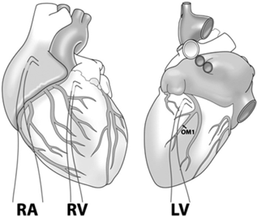
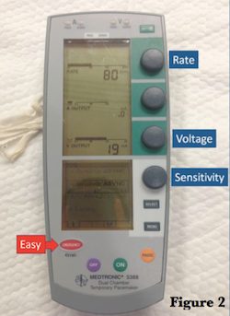
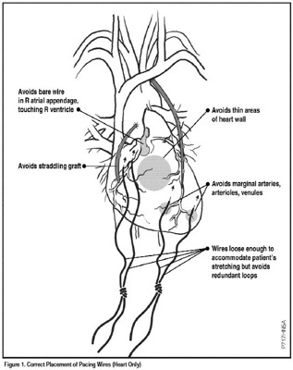
Check Output & Sensitivity Thresholds Daily!!!! WHY?

Slide 37
Daily Calibration of Epicardial Pacers Protocol
Bravein Amalakuhan, MD

Slide 38
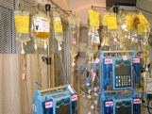
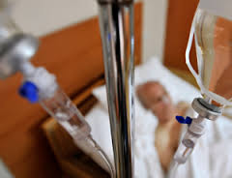
SEDATION & PAIN CONTROL
Stephens et al. CCM (2015)
Oliver et al. JCVA (2011)
Curtis et al. JCVA (2013)
Upon arrival from OR
Preferred Agents:
Propofol + Fentanyl [vs. Fent + Versed Drip]
Faster extubation times
Ongoing Needs during CSICU
Precedex Drips (sedation and analgesic effects)
Wean drips and place on intermittent narcotics doses ASAP
Once extubated → Patient-controlled analgesia (PCA) devices
Once tolerating PO, will transition to oral narcotic regimens
STS QUALITY ALERT

Slide 39
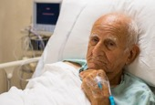

DELIRIUM
Stephens et al. CCM (2015)
Barr et al. CCM (2013)
Ji et al. JCVA (2014)
Risk-Factors:
Benzodiazepine use
Restraints
Immobilizing Therapeutic Devices (IABPs, VADs)
Poor Outcomes:
Prolonged mechanical ventilation
Increased Mortality
Treatment/PPX:
Periop Precedex Drips and PPX:
Decreases incidence of delirium and mortality
Treatment:
No data for early mobilization or atypical antipsychotics
Haldol/Antipsychotics still used !
STS QUALITY ALERT

Slide 40
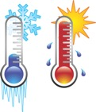

HYPOTHERMIA & REWARMING
Hypothermia:
Most Cardiac Surgeries: Cooled to 34 deg C
Aortic Procedures: Mod-to-Deep Hypothermia (~18 deg C)
Consequences of Hypothermia:
Interferes with coagulation
Predisposes to arrhythmias
Decreases cardiac output (and increases afterload)
Delays weaning from Mechanical Ventilator
Upon Arrival to the CVSICU:
Rewarming Rate: Goal: 0.2 deg C/minute
Mode: Forced air warming devices are most effective
Saad et al. GCSP (2013
Nussmeier. THIJ (2005))

Slide 41
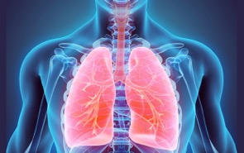
VENTILATOR SUPPORT/MANAGEMENT
Respiratory Complications post Cardiac Surgery
Restrictive physiology
Pulmonary edema
Decreased lung compliance
Atelectasis
Phrenic nerve injury in a minority
Ventilatory Strategy:
Target Tidal Volume: 6cc/kg
Avoid hypercarbia → increases RV afterload
Goal ph of 7.35-7.45
[mild respiratory alkalosis is recommended]
Stephens et al. CCM (2015)

Slide 42
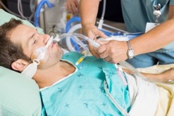
VENTILATOR SUPPORT/MANAGEMENT
Ventilator Weaning Protocol
Wean oxygen
Rewarm to 36 degrees C
Reverse NMB
Wean Sedation
Perform Spontaneous Breathing Trial
GOAL: EXTUBATION WITHIN 6-HOURS
ASSOCIATED WITH IMPROVED MORBIDITY AND MORTALITY
STS QUALITY ALERT
Stephens et al. CCM (2015)

Slide 43
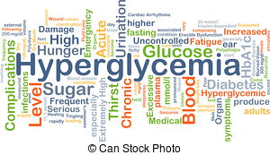
GLYCEMIC CONTROL
Significance
Reduces risk of
Deep sternal wound infections
All-cause infections
Sepsis
Mortality
Goal:
BGM < 180 mg/dl for the first 2 post-operative days
Tools:
Insulin drip x 24hrs
Transitioning to sc insulin on POD#1
STS QUALITY ALERT
Associated with improved morbidity and mortality!!!!
Stephens et al. CCM (2015)
Lazarus et al. ATS (2009)

Slide 44
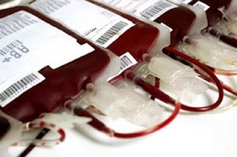
PRBC TRANSFUSION STRATEGIES
2 RCTs Evaluated Goals in Cardiac Surgery Patients
Transfusion Requirements after Cardiac Surgery Trial
Transfusion Indication Threshold Reduction Trial
Summary of Results
Goal: Hb 8 g/dl (or Hct >24%)
No difference in clinical outcomes between a Hb of 8 g/dl vs. 10 g/dl
Benefits of the restrictive approach
60% reduction in transfusions
Decreased costs
Decreased complications
Stephens et al. CCM (2015)
Lazarus et al. ATS (2009)
Hajjar et al. JAMA (2010)

Slide 45
DE-ESCALATION OF CARE
Extubate within 6-hours
Diet:
Evaluate swallowing function and commence clear liquids
Advance diet as tolerated
6-24 Hrs after ICU Admission
Inflammatory effects of surgery/CPB subside
Inotropes/vasoactive agents weaned off
Avg Net Fluid Balance POD#0 = +6L [Intra-op and in the CSICU]
Morning of POD#1
Begin diuresis: Goal Fluid Balance = -1-2L/24hrs
If adequate Uout→ remove foley
Remove CVC’s and A-lines
Ambulate
Stephens et al. CCM (2015)

Slide 46

DE-ESCALATION OF CARE
Morning of POD#2:
Can remove epicardial pacer wires
Chest drains can be removed if:
Output <100cc/8hr or <15-20cc/hr
No air-leak
DOWNGRADE OUT OF ICU
Stephens et al. CCM (2015)

Slide 47
CARE OF THE POST-OPERATIVE HEART PATIENT
PART 2
BREAK
Bravein Amalakuhan, MD
Division of Pulmonary and Critical Care Medicine University of Texas Health, San Antonio

Slide 48
OUTLINE
PART 1
Culture & Psychology
Cardiac Surgical Critical Care: The Entity
Understanding Cardiopulmonary Bypass
Hand-offs & Routine Post-Operative Care
Procedure Specific Considerations/
Management
Management of Common Complications
STS Quality/Performance Measures
Foundational Knowledge
The Basics
POD#0 to Downgrade
PART 2
Advanced Details
“Emergencies”
APPLICATION

Slide 49
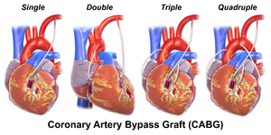
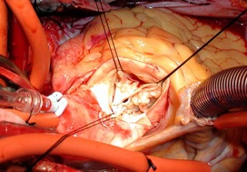
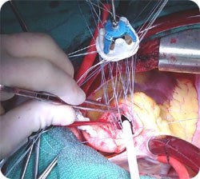

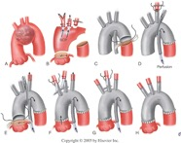
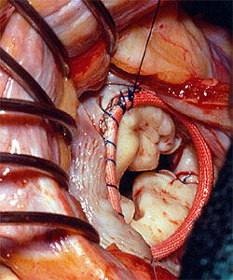
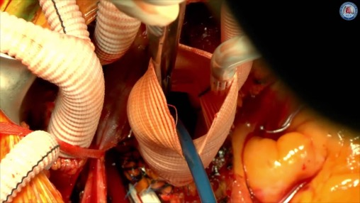
PROCEDURE SPECIFIC CONSIDERATIONS

Slide 50
CORONARY ARTERY BYPASS GRAFTS (CABG)

Slide 51
CABG: CONDUITS
Left Internal Mammary Artery (LIMA)
Conduit of choice for bypassing the LAD
Long-term patency
Right Internal Mammary Artery (RIMA)
Used in those 65-years old and younger
Long-term patency
Saphenous Veins
Used to bypass most vessels other than the LAD
Prone to re-stenosis
Radial Arteries
Used only if RIMA is unable to be harvested
Muscular wall --> Proned to Spasm
Long-term CCB post-op
12% Failure Rate at 10 yrs
STS QUALITY ALERT
12% Failure Rate at 10 yrs
STS QUALITY ALERT
50% Failure Rate at 10 yrs
Rarely used
Little LTM Data
Stephens et al. CCM (2015)

Slide 52

TYPES OF BYPASS GRAFTS
CABGX3
CABGX2
CABGX2
CABGX3
CABGX4

Slide 53




GRAFT HARVESTING
SVG
LIMA & RIMA
SVG
SVG

Slide 54
CABG: MEDICATIONS & QUALITY METRICS
Aspirin:
Outcomes:
Improves long-term graft patency, reduces mortality, MI, stroke, bowl infarction and AKI after CABG
Admin Timing: Pre-op + Within 6-hours post-op
Duration: Indefinitely
Dosing: ASA 100-325mg daily
Statins:
Outcomes:
Decreases incidence of atrial fibrillation, adverse coronary events, risk of graft occlusion, AKI and all cause mortality after CABG
Admin Timing: As soon as tolerating oral intake post-op
Duration: Indefinitely
Dosing: Atorvastatin 40-80mg daily
Aspirin
STS QUALITY ALERT
Statins
STS QUALITY ALERT
Stephens et al. CCM (2015)

Slide 55
CABG: MEDICATIONS & QUALITY METRICS
Beta Blockers:
Outcomes:
Decreases incidence of atrial fibrillation, myocardial ischemia and all-cause mortality after CABG
Admin Timing: Pre-op and Post-op once hemodynamically stable
Duration: Indefinitely
Dosing: Start at low doses and titrate up [Metoprolol 12.5mg BID]
ACEi or ARBs:
Indication: For those on it pre-op and de-novo post-op if patient has a decreased LV EF, DM or CKD
Admin Timing: Post-op once hemodynamically stable
Duration: Indefinitely
Dosing: Lisinopril 40mg Daily
Beta-Blockers
STS QUALITY ALERT
ACEi or ARBS
STS QUALITY ALERT
Stephens et al. CCM (2015)

Slide 56
CARDIAC VALVE SURGERY

Slide 57
CARDIAC VALVE SURGERY: GENERAL PRINCIPLES
Valve surgery has a higher mortality rate vs. CABG
Aortic Valve: 2x Higher Risk
Mitral Valve: 3x Higher Risk
Tricuspid Valve: 4x Higher Risk
Anticoagulation:
Bioprosthetic Valves:
ASA is usually sufficient
Some studies recommend short-term Oral AC (8 wks)
Mechanical Valves:
Life-long AC (started on POD #1 or 2)
Heparin Drip then Oral AC
Oral AC only (without Heparin bridge)
Risk:
Repair < Replacement
OR
Stephens et al. CCM (2015)

Slide 58
CARDIAC VALVE SURGERY: GENERAL PRINCIPLES
Post-operatively patients will initially face ventricular failure and significant arrhythmias
Weeks-to-Months
Inflammation will resolve
Recovery from operative ischemic injury
Ventricular remodeling will occur
Ejection Fraction Will Improve/Resolve
Stephens et al. CCM (2015)

Slide 59

MITRAL VALVE (MV) SURGERY: Things to Anticipate Post-Op
Left Ventricular Failure:
Common after MV repair/replacement for Mitral Regurgitation (MR)
The newly competent MV no longer serves as a low-pressure “pop-off” valve for the LV → Increased LV afterload
Treatment:
Afterload Reduction: Nitro/Nitroprusside Drips, IABP
Inotropy: Levo +-Dobutamine
Right Ventricular Failure:
Common after long-standing Mitral Stenosis (MS) or MR due to pulmonary venous hypertension
The stress of surgery may cause RV failure
Treatment:
Inotropy + inhaled pulmonary vasodilators
Transient!!!
Stephens et al. CCM (2015)

Slide 60


MITRAL VALVE (MV) SURGERY: Things to Anticipate Post-Op
Systolic Anterior Motion (SAM) of the Anterior MV leaflet
Due to mismatch between the leaflet tissue and mitral annular size
Dynamic LV outflow tract obstruction due to this abnormal leaflet
Treatment:
Avoid an under filled & hyperdynamic LV
Fluids, avoid inotropes, minimize tachycardia (B-blockers)
Surgical revision is rarely needed
Stephens et al. CCM (2015)

Slide 61
MITRAL VALVE (MV) SURGERY: Things to Anticipate Post-Op
Ventricular Ectopy
Etiology:
Chronic ventricular hypertrophy leads to subendocardial ischemia
Prone to sudden ventricular fibrillation
Prevention:
Careful attention to K and Mg levels post-op
Treatment:
Amiodarone
Replace electrolytes
Defibrillation
Transient!!!
The Ventricles will adapt and slowly recover as inflammation resolves
Stephens et al. CCM (2015)

Slide 62


MITRAL VALVE (MV) SURGERY: Things to Anticipate Post-Op
Atrioventricular Groove Disruption/Rupture
Occurs inadvertently after extensive debridement of a calcified mitral annulus.
Presents with massive bleeding in the OR or in CSICU (delayed)
Treatment: Surgery
Stephens et al. CCM (2015)

Slide 63
AORTIC VALVE (AV) SURGERY: Things to Anticipate Post-Op
Very Fluid/Pre-load Responsive:
The hypertrophied LV is very sensitive to pre-load post-op
Focus on fluid resuscitation first before inotropy during signs of hypotension
Post-Operative HTN Should be Avoided:
Rationale
To limit stress on this aortic suture line
Sudden increases in bleeding should raise concern regarding the integrity of the aortotomy closure site
Treatment:
Goal SBP <120mmHg [use afterload reducers] or 20% less than pre-operative level
Stephens et al. CCM (2015)

Slide 64
Fragile Aortotomy Site after AV Replacement/Repair

Slide 65
AORTIC VALVE (AV) SURGERY: Things to Anticipate Post-Op
Conduction Disturbances:
Etiology:
Sutures are often inadvertently placed through the conduction system due to their proximity to the AV
Local inflammation from the AV surgery
Surveillance:
Daily EKG’s to evaluate intervals
Presentation:
Presents within the 1st 3-days post-op
~7% require permanent pace-makers
Treatment:
Temporary Epicardial Pacing
Transient!!!
The Ventricles will adapt and slowly recover as inflammation resolves
Stephens et al. CCM (2015)

Slide 66




AV and Anatomical Proximity to the Electrical Conduction System

Slide 67


AORTIC VALVE (AV) SURGERY: Things to Anticipate Post-Op
LV/RV Failure + Refractory Ventricular Arrhythmias
Etiology:
Malposition of aortic valve prosthesis may occlude coronary ostia
RCA is particularly at risk
Treatment:
Surgical Repair
AV and Anatomical Orientation/Proximity to the Coronary Ostia
Stephens et al. CCM (2015)

Slide 68
AORTIC VALVE (AV) SURGERY: Things to Anticipate Post-Op
Ventricular Ectopy:
Etiology:
Chronic Ventricular Hypertrophy leads to subendocardial ischemia
Treatment:
Amiodarone
LV Failure:
Etiology:
In those with previous AR → now with increased afterload from newly competent AV
Treatment:
Afterload reduction (e.g. IABP, Nitroprusside drip)
Inotropy
Transient!!!
The Ventricles will adapt and slowly recover from the operative ischemic injury!
Stephens et al. CCM (2015)

Slide 69

AORTIC VALVE (AV) SURGERY: Things to Anticipate Post-Op
Ischemic CVA
Etiology
Manipulation of the aorta with plaque/calcification rupture and embolization
Treatment:
Supportive
STS QUALITY ALERT
Stephens et al. CCM (2015)

Slide 70

TRICUSPID VALVE (TV) SURGERY:
Less common than other valve operations because:
Isolated tricuspid disease is rare
AV and MV pathology can cause “functional TR”
Repairing the primary pathology will resolve the TR
Some reports of increased mortality when combining TV repair with other valvular surgeries (AV/MV repair/replacement)
Highest incidence of heart block [High Risk of Complications]
Surgeons will usually place a permanent epicardial pacemaker lead intra-op
Highest mortality rate among all valvular surgeries
Poor Outcomes with Tricuspid Replacement [vs. Repair]
Higher risk of: RV failure, renal failure, mortality
Stephens et al. CCM (2015)

Slide 71
ASCENDING AORTA & ARCH SURGERY

Slide 72


ASCENDING AORTA & ARCH SURGERY PROCEDURES TYPES
Aneurysm Repair with Interposition Tube Grafts
Aneurysmal area is cut out and an artificial graft is sown end to end
Coronary Sinuses/Origins are preserved
AV is preserved
Stephens et al. CCM (2015)

Slide 73



ASCENDING AORTA & ARCH SURGERY PROCEDURES TYPES
Aortic Root Replacement
An area of diseased aorta is removed and an artificial graft is sown in its place
The coronaries are removed and re-attached to the aorta
The AV is replaced
Stephens et al. CCM (2015)

Slide 74


ASCENDING AORTA & ARCH SURGERY PROCEDURES TYPES
Aortic Arch Replacement
Arch Vessels are removed
Arch is replaced with a graft
Arch vessels are re-implanted sown to the graft
Stephens et al. CCM (2015)

Slide 75


ASCENDING AORTA & ARCH SURGERY PROCEDURES TYPES
Emergent Repair of Dissections
Graft/stent can be placed to dissected area
If dissecting into vessels, the entire arch/dissected area can be replaced
Stephens et al. CCM (2015)

Slide 76

ASCENDING AORTA & ARCH SURGERY THINGS TO ANTICIPATE POST-OP
Neurologic Injury:
Causes:
Embolization of atherosclerotic debris or
air into the open arch and head vessels
Ischemia 2/2 hypoperfusion
Treatment: Supportive
Severe Bleeding:
Causes:
Aortic surgeries require deep hypothermic circulatory arrest (~18 deg C) to limit cerebral/somatic ischemia
Hypothermia → worsens coagulopathy
Treatment: Re-warm
Stephens et al. CCM (2015)

Slide 77


BP Monitoring is KEY!!!!!
Right Radial A-Lines:
Better Reflects Perfusion To:
1.Coronaries
2.Cerebral Vessels
3.Proximal Aortic Arch

Slide 78
ASCENDING AORTA & ARCH SURGERY THINGS TO ANTICIPATE POST-OP
Asymmetric Blood Pressures
Monitoring:
Ensure right and left radial A-lines are in place post-op
A sign of iatrogenic dissection or vascular occlusion
Treatment:
Surgical Repair
Fragile Aortic Anastomotic Suture Sites
Monitoring
Avoid HTN
Treatment:
Afterload reduction
Limit SBP to < 120 mmHg or 20% below pre-op levels
Stephens et al. CCM (2015)

Slide 79
ASCENDING AORTA & ARCH SURGERY THINGS TO ANTICIPATE POST-OP
Coronary Occlusion and Ventricular Failure / Ischemia
Aortic Root Replacements require re-implantation of coronary arteries into the graft
Coronary kinking/occlusion may occur
Treatment:
Surgical repair
ARDS:
Aortic procedures are at higher risk of developing post-op ARDS vs. other cardiac procedures
Treatment:
Low-Vt ventilation immediately post-op for ppx and treatment
Stephens et al. CCM (2015)

Slide 80
MANAGEMENT OF COMMON COMPLICATIONS

Slide 81
EXCESSIVE BLEEDING
Definitions:
>1000 ml over a 12-hr period
>400cc/hr x 1-hr
>300cc/hr x 2-hrs
>200cc/hr x 3-hrs
Outcomes:
>200ml in 1-hr
>1000 ml in first 24-hrs
Risk-Factors:
Age >75yo, pre-op anemia, emergent/complex operations, AV/Aortic procedures, use of IMA, long CPB time, low EF, low BMI, male
Increased Mortality
STS QUALITY ALERT
Stephens et al. CCM (2015)

Slide 82
EXCESSIVE BLEEDING
Treatment:
Correct hypothermia
Correct acidosis
Limit SBP to 90-100 mmHg [begin afterload reduction]
Blood product transfusion:
PRBC:FFP:PLT = 2:2:1 if actively bleeding
Give cryoprecipitate if fibrinogen < 100 mg/dl
Consider Recombinant Factor VIIa
Increased risk of thrombotic complications in 25-50% of patients [Risk:Benefit]
Discuss with Surgeon → Surgical Re-Exploraton?
Stephens et al. CCM (2015)

Slide 83
CARDIAC TAMPONADE
Types:
Medical Tamponade:
Circumferential fluid accumulation
Post-Op Tamponade:
Even a localized/small posterior pericardial fluid collection can cause it!!!!!!
Cause by undrained blood/clot
Classic signs are absent [e.g. pulsus paradoxus, Beck’s Triad, TTE findings]
Suspect when chest tube output suddenly stops
TEE is most sensitive study
Stephens et al. CCM (2015)

Slide 84
REFRACTORY SHOCK
Definition
Shock despite optimization of preload, afterload and inotropic support
Outcomes:
High inotrope doses → Ischemia → Worse outcomes
Treatment:
Early use of mechanical support to avoid MOF
Intra-Aortic Balloon Pumps
Impella Device
LVAD (e.g. Heart Mate II)
ECMO
Stephens et al. CCM (2015)

Slide 85






IABP
IMPELLA
LVAD

Slide 86



VA ECMO

Slide 87


POST-OPERATIVE CARDIAC ARREST
ACLS protocols have limited applicability in the CSICU
What’s DIFFERENT?:
Chest compressions are higher risk in Post-op Cardiac Pts
Cardiac arrests are usually witnessed immediately → TIME IS ON THEIR SIDE!! → Shock/Pace FIRST
Guidelines for Post-Operative Cardiac Arrest
Cardiac Advanced Life Support-Surgical
Cardiac Surgery Unit-Advanced Life Support
Stephens et al. CCM (2015)
Dunning et al. EJCS (2009)
Herrmann et al. AACN ACC (2014)

Slide 88
Attempts at Defibrillation or Pacing Take Precedence over Chest Compressions
Do Not Delay Chest Compressions for > 1-minute
If no ROSC Within 5-minutes or After 3-shocks → Emergency Re-Sternotomy
In Succession
Chest Exploration for Reversible Causes:
-Tamponade (MCC)
-Massive Hemorrhage
-Tension Pneumothorax
Cardiac Massage
If No Reversible Causes Initiate Salvage ECMO

Slide 89
POST-OPERATIVE CARDIAC ARREST SPECIAL CIRCUMSTANCES
Stephens et al. CCM (2015)
Dunning et al. EJCS (2009)
Herrmann et al. AACN ACC (2014)
Cardiac Arrest in Patients with a IABP
Remove the ‘EKG trigger’ for the IABP
Will be triggered by artifact from chest compressions
Place on ‘Pressure Trigger’, 1:1 Counterpulsation at Max Augmentation
Will coordinate diastolic balloon inflation with chest compressions
Will help improve coronary perfusion
If preparing to shock and significant period without chest compressions → Set to ‘Internal Rate’ of 100bpm
Cardiac Arrest in Patients with LVAD Devices:
Check all the connections first! [Disconnected?] Give Fluids!
If nothing works start chest compressions!!!! [Last-resort]

Slide 90
SOCIETY OF THORACIC SURGEONS (STS) Quality & Performance Metrics
STS QUALITY ALERT

Slide 91

SOCIETY OF THORACIC SURGEONS (STS) STS Star Ratings: 1 -3
Below Average Performance
Average Performance
Above Average Performance

Slide 92
STS START RATING: CABG Surgeries
4-Domains
MORTALITY
MORBIDITY [ANY/NONE]
Mortality
In-hospital: Any-time
Discharge: Within 30-days of surgery
Morbidity [Any-or-None]
CVA/Stroke
Surgical re-exploration
Deep sternal wound infection rate
Post-operative renal failure
Prolonged Intubation (>24hrs)
OPERATIVE PROCESS
Operative Care Process
Use of a internal mammary artery (LIMA/RIMA)
MEDICATIONS [ALL/NOTHING]
Medications [All-or-None]
Pre-op BB
BB at d/c
Anti-PLT at d/c
Anti-lipid at d/c
SCORE ON 4-DOMAINS = STAR RATING [1-3]

Slide 93
QUALITY OPERATIVE CARE & QUALITY CVSICU CARE = “EQUIVALENT”
FOCUS ON THE SMALL THINGS
FOCUS ON QUALITY
Below Average Performance
Average Performance
Above Average Performance

Slide 94
References
Kumar K, Zarychanski R, Bell DD, et al; Cardiovascular Health Research in Manitoba Investigator Group: Impact of 24-hour in-house intensivists on a dedicated cardiac surgery intensive care unit. Ann Thorac Surg 2009; 88:1153–1161
Dimick JB, Pronovost PJ, Heitmiller RF, Lipsett PA. Intensive care unit physician staffing is associated with decreased length of stay, hospital cost, and complications after esophageal resection. Critical care medicine 2001;29(4):753-758.
Stephens RS, Whitman GJ. Postoperative Critical Care of the Adult Cardiac Surgical Patient. Part I: Routine Postoperative Care. Critical care medicine 2015;43(7):1477-1497.
Agarwal HS, Saville BR, Slayton JM, Donahue BS, Daves S, Christian KG, et al. Standardized postoperative handover process improves outcomes in the intensive care unit: a model for operational sustainability and improved team performance*. Critical care medicine 2012;40(7):2109-2115.
St Andre AC, DelRossi A. Hemodynamic management of patients in the first 24 hours after cardiac surgery. Critical care medicine 2005;33(9):2082-2093.
Hajjar LA, Almeida JP, Fukushima JT, Rhodes A, Vincent JL, Osawa EA, et al. High lactate levels are predictors of major complications after cardiac surgery. The Journal of thoracic and cardiovascular surgery 2013;146(2):455-460.
Breukers RM, Trof RJ, de Wilde RB, et al: Relative value of pressures and volumes in assessing fluid responsiveness after valvular and coronary artery surgery. Eur J Cardiothorac Surg 2009; 35:62–68
Trof RJ, Danad I, Reilingh MW, et al: Cardiac filling volumes versus pressures for predicting fluid responsiveness after cardiovascular surgery: The role of systolic cardiac function. Crit Care 2011; 15:R73
Potter BJ, Deverenne B, Doucette S, et al; Canadian Critical Care Trials Group: Cardiac output responses in a flow-driven protocol of resuscitation following cardiac surgery. J Crit Care 2013; 28:265–269
Oliver WC Jr, Nuttall GA, Murari T, et al: A prospective, randomized, double-blind trial of 3 regimens for sedation and analgesia after cardiac surgery. J Cardiothorac Vasc Anesth 2011; 25:110–119.
Ji F, Li Z, Young N, Moore P, Liu H. Perioperative dexmedetomidine improves mortality in patients undergoing coronary artery bypass surgery. Journal of cardiothoracic and vascular anesthesia 2014;28(2):267-273.
Barr J, Fraser GL, Puntillo K, et al. Clinical practice guidelines for the management of pain, agitation, and delirium in adult patients in the intensive care unit. Critical care medicine. 2013;41(1):263-306.
Nussmeier NA. Management of temperature during and after cardiac surgery. Texas Heart Institute journal 2005;32(4):472-476.
Lazar HL, McDonnell M, Chipkin SR, et al; Society of Thoracic Surgeons Blood Glucose Guideline Task Force: The Society of Thoracic Surgeons practice guideline series: Blood glucose management during adult cardiac surgery. Ann Thorac Surg 2009; 87:663–669

